Slide 1
THE NEWBORN
D.AGEDO

Slide 2
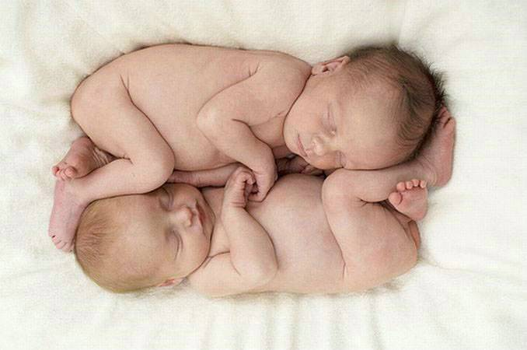

Slide 3
objectives
By the end of this session the student should be able to:
Define normal neonate/newborn
Describe the characteristic of the neonate
Describe the physiologic adaptation of the neonate
Care for the newborn immediately after birth & during the neonatal period

Slide 4
DEFINITION
Newborn is a live baby born either normal or as high risk irrespective of the gestational age
Neonate refers to a baby with the first 28 days of life
Infant refers to a baby with the first year of life

Slide 5
Term neonate is a baby born after 37 weeks gestation
Preterm neonate is a baby born before 37 weeks gestation
Post-term neonate is a baby born after 42 weeks gestation

Slide 6
THE NEWBORN
a baby born between 37 – 40 weeks average birth weight between 2500 – 4000grammes

Slide 7
CHARACTERISTIC OF A NEONATE
general appearance
Posture slightly flexed
SKIN
Colour range from bright pink to dark
opaque with no visible blood vessels
Vernix caseosa covering skin folds/creases & between the labia
Delicate & is easily traumatised

Slide 8
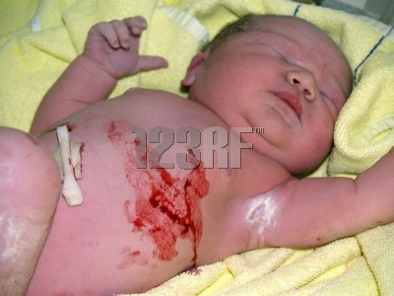
Vernix Caseosa

Slide 9
Length 50cm
Weighs between 3.5-4kg
HEAD
Hair is soft & silky (if present) should be evenly distributet
Head circumference (occipito-frontal) 35cm

Slide 10
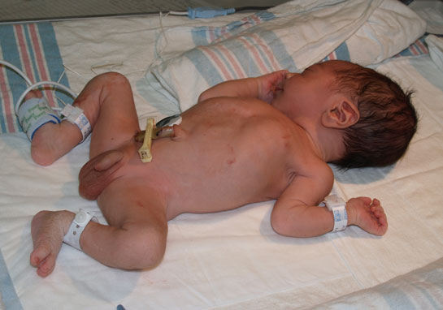
Posture

Slide 11
The suture the be seperated
The anterior &the posterior fontanelle are present
Anterior fontanelle closes at 12-18 months & posterior between

Slide 12
ANTERIOR
POSTERIOR
DIAMOND SHAPED
LOCATED AT THE JUNCTION OF THE 2 PARIETAL & FRONTAL BONES
2-3CM WIDTH & 3-4CM LENGTH
CLOSES BETWEEN 12-13 MONTHS
TRIANGULAR SHAPED
LOCATED AT THE JUNCTION
OF THE PARIETAL & OCCIPITAL BONES
CLOSES BY 2ND MONTH

Slide 13
EYES
2 of equal size
Eye movement are poorly coordinated initially
Eyebrows eyelashes should be present
The canthus of the eyes should be in line with the upper notch of the earlobe

Slide 14
Nose
Present with 2 nostrils seperted by a septum

Slide 15
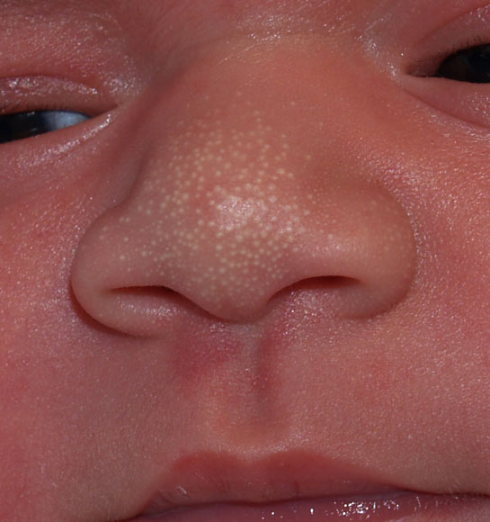
Normal Nose

Slide 16
MOUTH
Lip are well formed
Gums appear quite irregular edge
No teeth in the gums
Tongue should fit in the mouth
High arched palate
Minimal salivation

Slide 17
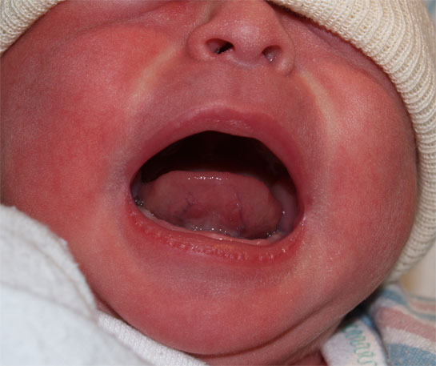

Slide 18
EARS
2 lobe present one on either sides of the head
The cartilage well formed
Easily recoils
External Auditory meatus is patent

Slide 19
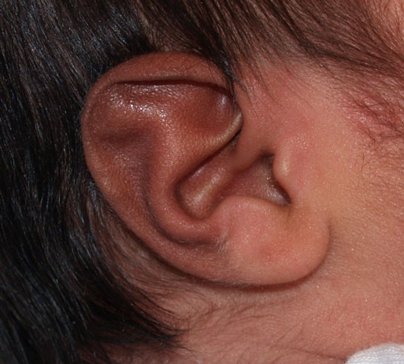
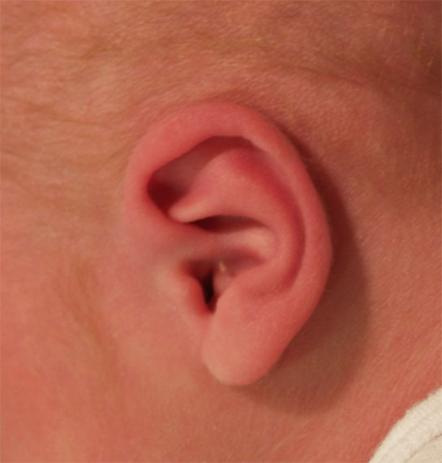
Normal Ears

Slide 20
NECK
Short thick usually surrounded by skin folds

Slide 21
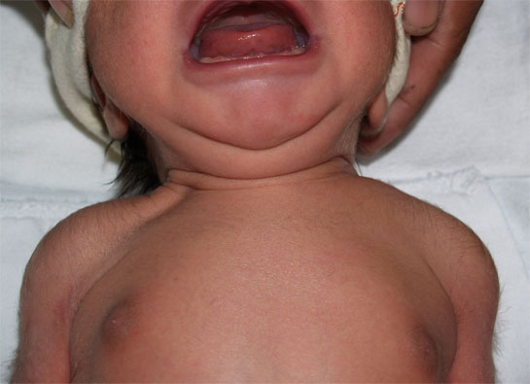
Neck

Slide 22
CHEST
Breast tissue present on either side of the chest
Symmetrical chest movement
Chest & abdominal movement well sychronized
Regular respiratory movements
Xiphestrenal process evident

Slide 23
ABDOMEN
Smooth & round
No visible blood vessel
Umbilicus –
healthy looking whitish cream in colour with watson jelly
2 ateries and a vein present

Slide 24
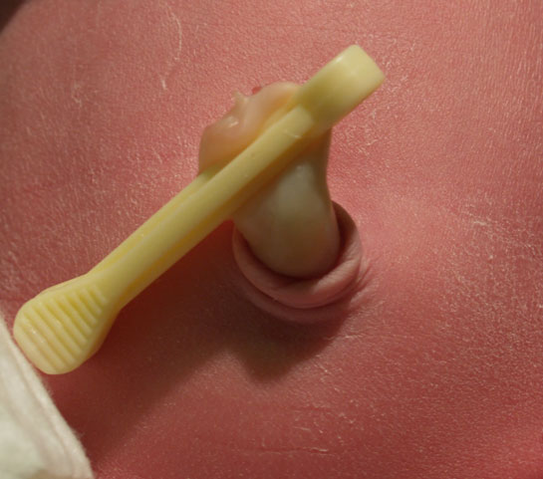

Slide 25
GENITALIA
Male
Urethral opening is at the tip of the
glans penis
Testes are palpable in each scrotum
Scrotum is pigmented, pendulous & covered with rugae

Slide 26
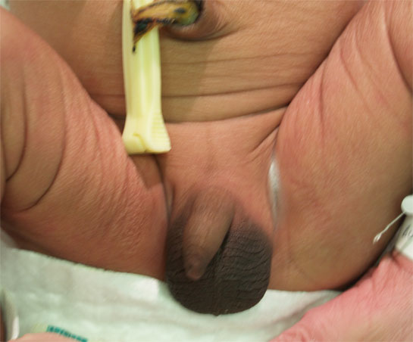

Slide 27
FEMALE
Labia majora covers labia minora
Urethral meatus is located behind the clitoris
Vernix caseosa is present between the labia

Slide 28
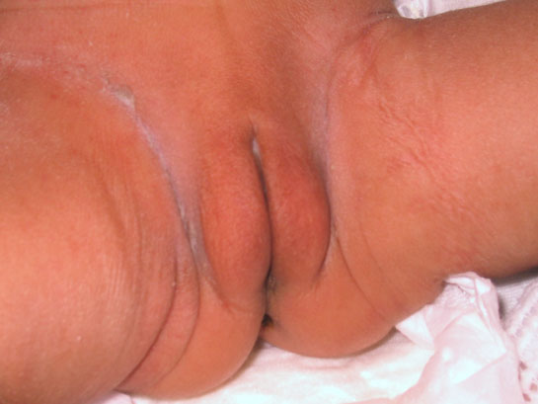
Female genitalia

Slide 29
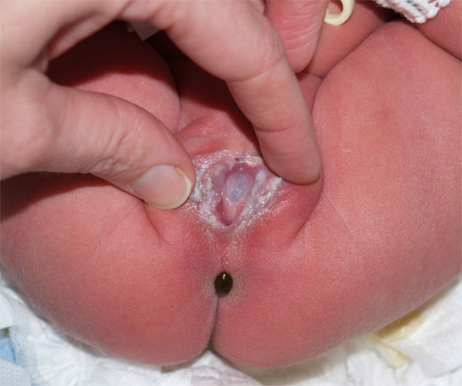

Slide 30
LIMBS & DIGITS
2 Hand & 2 foot presenthave 5 digits each
Palmar creases present in hands
Clenched fit
Creases covers anterior 2/3rd of the sole of the foot

Slide 31
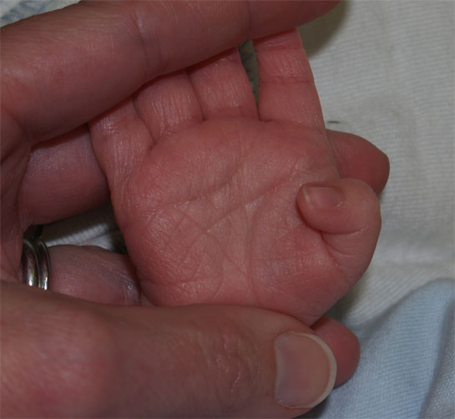
Nail beds pink

Slide 32
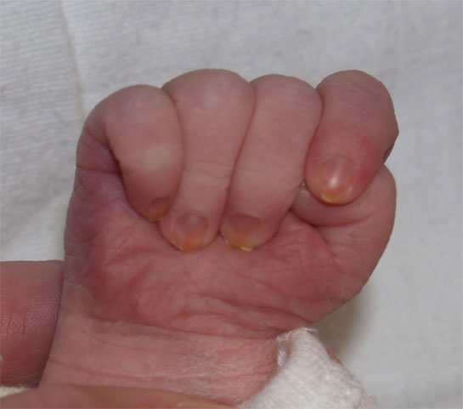

Slide 33
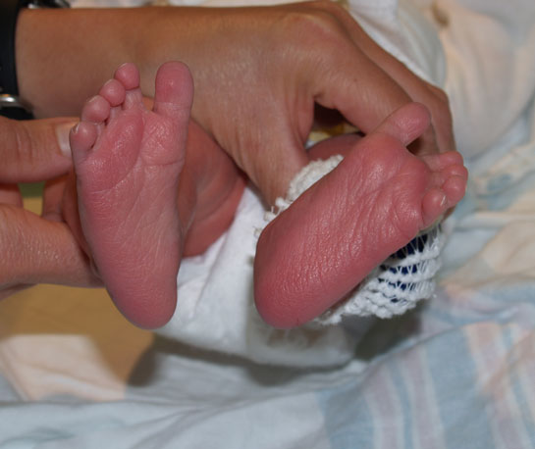
Extremities
Creases on anterior two thirds of sole.

Slide 34
Vertebrea column is continous
Anus is patent

Slide 35
